Slide 1
PROFESSIONAL ETHICS CE 3142
INSTITUTION OF ENGINEERS, SRI LANKA
CODE OF ETHICS
THE KOTHELAWELA DEFENCE UNIVERSITY
FACULTY OF ENGINEERING
2nd February 2024

Slide 2
Topics
Institution of Engineers, Sri Lanka
The Chartered Engineer
IESL - Code of Ethics
ECSL – Code of Ethics
Disciplinary Procedures

Slide 3

ETHICS
The discipline dealing with what is good and bad, and with moral duty and obligation

Slide 4
The Institution of Engineers, Sri Lanka
In 1904, 19 senior government officials, 14 of whom were Engineers, stationed around Anuradhapura, formed the North-Central Province Association.
They met monthly to discuss and record their work and exchange ideas on scientific and engineering developments
In 1906, together with Engineers and other interested professionals in the rest of the Island, the Engineering Association of Ceylon was formed.
In addition to Engineers, there were Architects, Surveyors and Archeologist
In 1956 the membership resolved to re-constitute the Engineering Association of Ceylon, and the Institution of Engineers, Ceylon was born

Slide 5
The Institution of Engineers, Sri Lanka
This was recognised by the Government and incorporated by the Institution of Engineers, Ceylon Act No. 17 of 1968.
Following on the establishing of the Republic of Sri Lanka, the Institution name was changed by Institution of Engineers, Ceylon (Amendment) Act No. 3 of 1996 to the Institution of Engineers, Sri Lanka.
The IESL is recognised under the Washington and Sydney Accords for the Accreditation of Engineering Programmes
The IESL is also recognised by the International Engineering Alliance, formerly Engineers Mobility Forum, for awarding the International Professional Engineer
The IESL presently has over 20,000 members

Slide 6
THE CHARTERED ENGINEER
A Chartered Engineer is one who is capable of assuming personal Professional Responsibility for the analysis and application of Engineering principles in the fundamental processes of Investigation, Planning, Design, Construction, Operation, Maintenance, Management and Development of Engineering works or plant, or in Engineering Research and/or Engineering Education.
He/she will be involved with the identification of solutions to problems, management and direction of high-risk and resource intensive projects.
He/she is able to communicate THEIR ideas clearly, concisely and intelligibly to others. His/her work requires the exercise of original thought and judgement, and the ability to supervise the Technical and Managerial work of others.
Professional judgement is the key feature of his/her role, applied to the assumption of responsibility for the direction/ demonstration of important tasks, including the profitable management of industrial and commercial enterprises.

Slide 7
CORPORATE MEMBER
A Corporate Member of the IESL is one who has satisfied the Council of the IESL that he/she has attained such standard of education, training and experience as required by the Council to testify to his/her proficiency as a Chartered Engineer. He/she should be on the Roll of the Institution and is entitled to use the abbreviation CEng(Sri Lanka).
Every individual member of the profession shall at all times so order his/her conduct so as to uphold the dignity and reputation of his/her profession and to safeguard the public interest in matters of safety, environment and health and otherwise. He/she shall exercise his/her professional skill and judgement to the best of his/her ability and discharge his/her professional responsibilities with integrity.

Slide 8
CORPORATE MEMBER
ACADEMIC :
A full time four year engineering degree accredited by the Institution completed after passing three subjects including Mathematics at the GCE (Advanced Level) Examination in the PHYSICAL science stream
  Recognized Training and Responsible Experience
A minimum of forty eight (48) months in aggregate of Recognized Training and Responsible Experience, divided into two periods of 24 months recognized training and 24 months responsible experience

Slide 9
The Institution of Engineers, Sri Lanka
Professional Review
The Professional Review shall comprise:
An assessment of Recognized Training and Responsible Experience gained by the candidate
An evaluation of the Report on Recognized Training and Responsible Experience
An evaluation of the Design and calculations, drawings, specifications, BOQ or Project
    A Presentation in powerpoint not exceeding 20 minutes, highlighting how the Key Competences have been met.
An interview by a panel of two (2) Corporate Members to assess the candidate’s compliance with the five core Competences
Written Tests – “A” Paper & “B” paper.

Slide 10
The Institution of Engineers, Sri Lanka
Professional Review
FIVE COMPETENCES EXPECTED OF A CHARTERED ENGINEER
(1) Demonstrates knowledge and understanding of engineering principles
(2) Demonstrates practical application of engineering knowledge and expertise
(3) Leadership and Management
(4) Communication & Personal skills
(5) Professional & Conduct

Slide 11
THE ENGINEERING COUNCIL OF SRI LANKA
The ECSL was established in August 2018 by Act No.4 of 2017.
The ECSL is responsible for maintenance and conduct of engineering practitioners, and will register these categories
  Chartered Engineer
  Associate Engineer
  Affiliate Engineer
  Incorporated Engineer
  Diplomates - IIESL
  Engineering Technicians - DVT
IESL

Slide 12
Why have a Code of Ethics?
to define accepted/acceptable behaviours;
to promote high standards of practice;
to provide a benchmark for members to use for self evaluation;
to establish a framework for professional behaviour and responsibilities;
as a vehicle for occupational identity;
as a mark of occupational maturity.

Slide 13
IESL CODE OF ETHICS

Slide 14
Clause 1
Engineers shall hold paramount the safety, health and welfare of the public and proper utilization of the funds and other resources in the performance of their professional duties. It shall take precedence over their responsibility to the profession, sectional private interests, employers or to other engineers [THE PEOPLE]
As the first requirement places the interests of the community above all others, Engineers
1.1 shall be objective and truthful in professional reports, statements or testimony. They shall include all relevant and pertinent information in such reports, statements or testimony. {TRUTH}
1.2 shall endeavour at all times to maintain engineering services essential to public welfare. {SERVICE TO THE PUBLIC}
1.3 shall work in conformity with recognised engineering standards so as not to jeopardise the public welfare, health or safety. {STANDARDS}
Notes:
Service to Public:
Disruption through Trade-union action
Disruption due to poor project planning
Standards:
Engineering Standards
OHS and Environmental Standards
Conflict of Interest
Means working in the interest of employer, safeguarding his interest

Slide 15
Clause 1
1.4 shall not participate in assignments that would create conflict of interest between their (engineers) clients /employers and the public and shall advise the client of their (engineers) concerns. {CONFLICT OF INTEREST}
16
1.5 shall, in the event of their judgement being over-ruled in matters pertaining to welfare, health or safety of the community, inform their (engineers) clients or employers of the possible consequences and bring to their (clients) notice their (Engineers) obligations as professionals to inform the relevant authority {CONVICTION}
1.6 shall contribute to public discussion on engineering matters in their areas of competence, if they consider that by so doing they can constructively advance the well-being of the community .{ADVISE}

Slide 16
Clause 1 (contd.)
1.7 having knowledge of any alleged violation of this Code shall co-operate with the proper authorities in furnishing such information or assistance as may be required .{WHISTLE BLOWING}
1.8 shall not knowingly participate in any act which will result in waste or misappropriation of public funds. {DISHONESTY}
1.9 Shall actively contribute to the well being of society and, when involved, in any engineering project or application of technology, shall, where appropriate, recognize the need to identify, inform and consult affected parties to help resolve problems involved. {DIALOGUE]

Slide 17
CA SEEKS TO PLEASE SEC WHO WANTS AUDIT FIRM$ TO WHISTLE - BLOW
CA to incorporate ‘whistle-blowing‘ into Ethics Code –
The Institute of Chartered Accountants Sri Lanka (CA) plans to incorporate a 'whistle-blowing' element into its Ethics Code, a follow up to the Securities and Exchange Commission (SEC) saying recently that it wants audit firms to whistle-blow as and when they come across 'anything unusual' in listed firms they audit. "We want to look at fulfilling the expectations of the regulator by incorporating these elements in our Code' of Ethics,” President CA told the Business Times . He added that legislative action can be counter productive as it can be defensive and this (ethics code inclusion) is one way to accommodate progressive reforms.

Slide 18
Clause 2
Engineers shall always act in such a manner as to uphold and enhance the honour, integrity and dignity of the professional while safeguarding public interest at all times. [HONOUR OF THE PROFESSION]
This requires that the profession should endeavour by its behaviour to merit the highest esteem of the community. It follows therefore that engineers-
2.1 shall not involve themselves with any business or professional practice which they know to be fraudulent or dishonest in nature. {DISHONESTY}
2.2 shall not use association with other persons, corporations or partnerships to conceal unethical acts. {ASSOCIATIONS}
2.3 shall not continue in partnership with, or act in professional matters with any engineer who has been removed from membership of this Institution because of improper conduct. {INTEGRITY}
Notes:
xxxxxx

Slide 19
Clause 2 (contd.)
2.4 shall promote the principle engagement of engineers on the basis of merit {MERIT}
2.5 shall uphold the principle of adequate & appropriate remuneration for professional engineering staff in keeping with their qualifications and market price {RECOGNITION}

Slide 20
Clause 3
Engineers shall be committed to the need for sustainable management of the planet’s resources and seek to minimize adverse environmental impacts of their engineering works or applications of technology so as to protect both present and future generations. [SUSTAINABILITY]
To this end engineers –
3.1 shall carefully evaluate adverse environmental impacts and incorporate practical remedial measures to minimize them. {ENVIRONMENTAL PROTECTION}
3.2 shall consider theoretical, legislative, regulatory and policy aspects of environmental protection and sustainable management of the available resources. {ENVIRONMENTAL PROTECTION}
3.3 Shall work in close co-operation with members of other professions and disciplines on achieving sustainable development {CO-OPERATION}

Slide 21
Clause 3 (contd.)
3.4 shall critically analyze how the proposed project or the application of technology relates to sustainability considerations. {ENVIRONMENTAL PROTECTION
3.5 shall identify and assess options for material recovery and disposal. {MINIMIZE/ REUSE OF WASTE & SAFE DISPOSAL}
3.6 shall analyze opportunities for resource and energy conservation and, design appropriately optimized systems. {CONSERVATION}

Slide 22
Clause 4
Engineers shall build their reputation on merit and shall not compete unfairly. [OWN ACHIEVEMENTS]
This requirement is to ensure that engineers shall not seek to gain a benefit by improper means. It follows that engineers-
4.1 shall neither pay nor offer, directly or indirectly, inducements including political contributions. {BRIBERY}
4.2 shall not attempt to supplant another engineer, employed or consulting, who has been appointed. {“UNDER CUTTING”}
4.3 shall neither falsify nor misrepresent their own or their associate’s qualifications, experience and prior responsibilities. {MISREPRESENTATION}
4.4 shall not maliciously do anything to injure, directly or indirectly, the reputation, prospects or business of others. {MALICIOUS TALK}

Slide 23
Clause 4 (contd.)
4.5 shall not use the advantage of a privileged position to compete unfairly with other engineers. {CONNECTIONS}
4.6 shall exercise due restraint in explaining their own work and shall refrain from unfair criticism of the work of other engineers. {MODESTY}
4.7 shall give proper credit for professional work to those to whom credit is due and acknowledge the contribution of subordinates and others. {ACKNOWLEDGE}
4.8 shall not resort to any type of plagiarism in their works {HONESTY}
4.9 shall act with due regards to Intellectual Property Rights of others in their works {ACKNOWLEDGE}
4.10 shall not engage in unfair competition , including charging of extremely high or low professional fees compared to market rates, in delivering professional services. {HONESTY}

Slide 24
What is Plagiarism?
To “plagiarise” is to :
to steal and pass off (the ideas or words of another) as one's own
to use (another's production) without crediting the source
to commit literary theft
to present as new and original an idea or product derived from an existing source
In other words, plagiarism is an act of fraud.
It involves both stealing someone else's work and lying about it afterwards

Slide 25
Clause 5
Engineers shall perform professional services only in the areas of their competence. [SPECIALIZATIONS]
To this end engineers-
5.1 shall undertake assignments only when qualified by education and experience in the specific technical fields involved. If an assignment requires qualifications and experience outside their fields of competence they shall engage competent professionals with necessary qualifications and experience and keep the employers and clients informed of such arrangements. {COMPETENCE}
5.2 shall not affix their signature to any plans or documents dealing with subject matter in which they lack competence, or to any plan or document not prepared under their direction or control. {HONESTY}

Slide 26
Clause 6
Engineers shall apply their skills and knowledge in the interest of their employer or client for whom they shall act, in professional matters, as faithful agents or trustees, so far as they do not conflict with the other requirements listed here and the general public interest. [LOYALTY]
It follows that engineers-
6.1 shall at all times avoid all known or potential conflicts of interest. They should keep their employers or clients fully informed on all matters, including financial interests, which could lead to such a conflict, and in no circumstances should they participate in any decision which could involve them in conflict of interest. {CONFLICT OF INTEREST}
6.2 shall when acting as administrators of a contract be impartial as between the parties in the interpretation of the contract. This requirement of impartially shall not diminish the duty of engineers to apply their skill and knowledge in the interests of their employers or clients. {NEUTRALITY}
6.3 shall not accept compensation, financial or otherwise from more than one party for services on the same project, unless the circumstances are fully disclosed and agreed to, by all interested parties. {GRATUITY}

Slide 27
Clause 6 (contd.)
6.4 shall neither solicit nor accept financial or other valuable consideration, including free engineering designs, from material or equipment suppliers for specifying their products (except such designs obtained with the knowledge and consent of the employer or client). {INTEGRITY}
6.5 shall neither solicit nor accept gratuities, directly or indirectly from contractors or their agents, or other parties dealing with their clients or employers in connection with work for which they are responsible. {BRIBERY}
6.6 Shall not accept a commission, fee, reward or other benefit from a third party, while advising a client . {BRIBERY}
6.7 shall advise their clients or employers when as a result of their studies they believe that a project will not be viable. (CONVICTION}

Slide 28
Clause 6 (contd.)
6.8 shall neither disclose nor use confidential information gained in the course of their employment without express permission (except where public interest and safety are involved). {CONFIDENTIALITY}
6.9 shall not complete, sign, or seal plans an/or specifications that are not of a design safe to the public health and welfare and in conformity with accepted engineering standards. If the client or employer insists on such unprofessional conduct, they shall notify the proper authorities and withdraw from further service on the project. {INTEGRITY}

Slide 29
Clause 7
Engineers shall give evidence, express opinions or make statements in an objective and truthful manner. [THRUTHFUL]
It follows that-
7.1 engineers’ professional reports, statements or testimony before any tribunal shall be objective and such opinions shall be expressed only on the basis of adequate knowledge and technical competence in the area, but this does not preclude a considered judgement based intuitively on experience and wide relevant knowledge. {PRECISE, KNOWLEDGABLE}
7.2 engineers shall reveal the existence of any interest, pecuniary or otherwise that could be taken to effect their judgement in a technical matter about which they are making a statement or giving evidence. {HONESTY}

Slide 30
Clause 8
Engineers shall continue their professional development throughout their careers and shall actively assist and encourage engineers under their direction to advance their knowledge and experience. [CPD]
The requirement here is that engineers shall strive to widen their knowledge and improve their skill in order to achieve a continuing improvement of the profession. It follows therefore that engineers-
8.1 shall encourage their professional employees and subordinates to further their education, {LIFE-LONG LEARNING}
8.2 shall take a positive interest in and encourage their fellow engineers actively to support the Institution and other professional engineering bodies which further the general interest of the profession. [INVOLVEMENT}

Slide 31
SUMMARY
The IESL Code of Ethics expects the Engineer to :
  Primarily be concerned about People
  Uphold the Honour of the Profession
  Ensure that they practice Environmental Sustainability
  To develop their reputation through their own Achievements
  Practice only in their areas of Specialization
  Be Loyal to their employers
  Be Truthful in reporting
  Be involved in Lifelong Learning

Slide 32
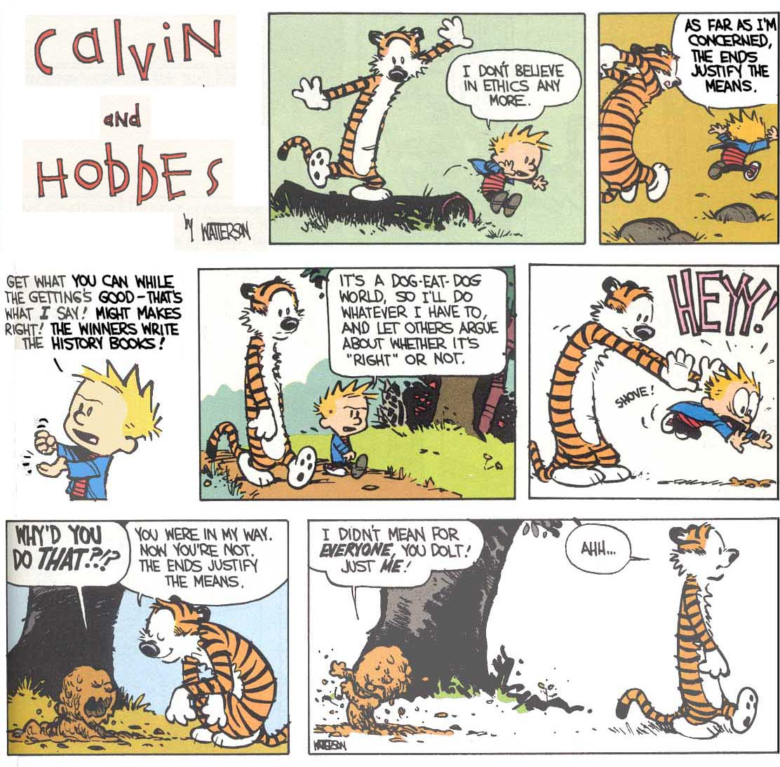

Slide 33
ENGINEERING COUNCIL SRI LANKA
CODE OF ETHICS

Slide 34
ECSL – CODE OF ETHICS
All Engineering Professionals, while in discharge of their professional duties, shall:
Uphold the highest standards of professional conduct including honesty, integrity, fairness, reliability and trustworthiness.
Hold paramount the safety, health, and welfare of the public and act with concern to minimise adverse effects on the environment in applications of engineering / technical solutions. [IESL 1, 3]
Perform professional services only in the areas of their competence while accepting responsibility for their professional advice, decisions and activities. . [IESL 5]

Slide 35
ECSL – CODE OF ETHICS
Avoid all conduct or practice that deceives the public or their employer and not be influenced in their professional discharge of duties by conflicts of interests. . [IESL 6]
Not attempt to damage/criticize, maliciously or falsely, directly or indirectly, the professional reputation, prospects, practice, or employment of other engineering professionals, give credit for professional work to whom credit is due and recognize the proprietary interests of others. . [IESL 4]
Issue public statements, professional reports, or testimony only in an objective and truthful manner, include all relevant and pertinent information in such reports, statements, or testimony. . [IESL 7]

Slide 36
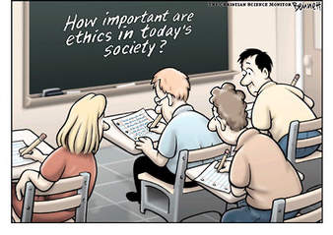

Slide 37
IESL DISCIPLINARY PROCEDURES

Slide 38
DISCIPLINARY PROCEDURES
Any member against whom an allegation of misconduct is made in writing by an individual or by an institution, shall be informed in writing by the President of the IESL of the allegation and shall be given an opportunity to vindicate himself of the charges (Vide By Law 33).
The President shall in consultation with the President - Elect will decide on whether the member has vindicated himself.
If the member is unable to vindicate himself, his case shall be referred to a Disciplinary Committee to investigate and report to the Council.

Slide 39
Disciplinary Panel and
Disciplinary Committee
  The Council at its first meeting for each session, will nominate six Fellows to constitute a Disciplinary Panel from whom a Disciplinary Committee (Vide By Law 31) will be selected to hear any disciplinary inquiry concerning the member.
  A Disciplinary Committee will be nominated by the Council.
  The Council will determine the Terms of Reference of such Disciplinary Committee and will also nominate a Chairperson.

Slide 40
DISCIPLINARY PROCEDURES
The member shall be notified in writing by the Executive Secretary :
  that charges have been formulated for determination by the Disciplinary Committee;
  the names of the members of the Disciplinary Committee;
  that he is required to respond to the charges in writing to the Chairman of the Disciplinary Committee within fourteen days from the date of such notification;
  that he is required to appear in person before the Disciplinary Committee at the time fixed for the hearing of the charges;
the schedule of evidence including the list of witnesses to be presented to the Disciplinary Committee in support of the charges;
the date, place and time fixed for commencement of the inquiry and the hearing of the charges by the Disciplinary Committee.

Slide 41
DISCIPLINARY PROCEDURES
The member may object against any member of the Disciplinary Committee on the grounds of prejudice. Reasons for such objection needs to be clearly stated. Objections to be considered by a committee comprising the President, the President - Elect and a Vice President.
The Executive Secretary shall present the case against the member at the first meeting of the Disciplinary Committee.
The Disciplinary Committee shall permit the member to be represented at the disciplinary inquiry by a Corporate Member of the Institution or he may decide to conduct his own defense.
The Disciplinary Committee shall endeavour to complete the inquiry within one month.
If the member is absents without a valid reason, the inquiry shall be adjourned and he/she shall be warned in writing by the Executive Secretary that proceedings will be held ex-parte.

Slide 42
DISCIPLINARY PROCEDURES
On the documentary evidence provided if the Disciplinary Committee considers it is not necessary to conduct an inquiry it may so decide.
If a detailed inquiry is decided upon, the following considerations as set out in Clause 10 of the IESL Disciplinary Procedure will apply
The Disciplinary Committee at any stage of the inquiry may seek legal advice if thought necessary with the approval of the President/ Council.
The decision of the Disciplinary Committee on any matter of procedures or any objection raised on procedural grounds shall be final.

Slide 43
DISCIPLINARY PROCEDURES
The decision and any recommendations of the Disciplinary Committee made at the conclusion of the inquiry shall be submitted to the President of the Institution within three weeks thereafter. The President shall submit the decision and recommendation of the Disciplinary Committee to the Council for action.
The Council may by resolution expel or suspend for any period from membership, reprimand or admonish any member found guilty of improper conduct. The Council may direct that such member shall make a contribution towards the expenses of the hearing before the Disciplinary Committee.
A member shall not be expelled except by a majority decision taken at a meeting of the Council at which at least two thirds of the membership of the Council is present.

Slide 44
DISCIPLINARY PROCEDURES
The order of the Council on the recommendation of the Disciplinary Committee shall be notified to the member by the Executive Secretary.
The member can appeal in writing within one month of the date of receipt of such notification
The Council may refer such appeal to the Disciplinary Committee for their observations. The decision of the Council shall be final and shall be conveyed to the member by the Executive Secretary.

Slide 45
ACKNOWLEDGEMENT:
https://www.feani.org
https://www.ice.org.uk/about-ice/who-runs-ice/how-we-work/conduct-policy
https://www.ieee.org
http://www.asce.org/codeofethics/
IESL web site - www.iesl.lk/
https://ecsl.gov.lk/code-of-ethics
http://www.shutterstock.com

Slide 46


Slide 47
THANK YOU

